Slide 1
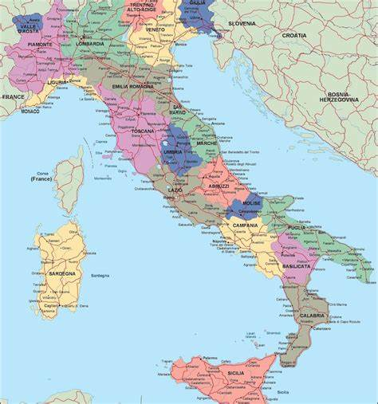
AMS
Leo Folliero Alessia 08399A

Slide 2
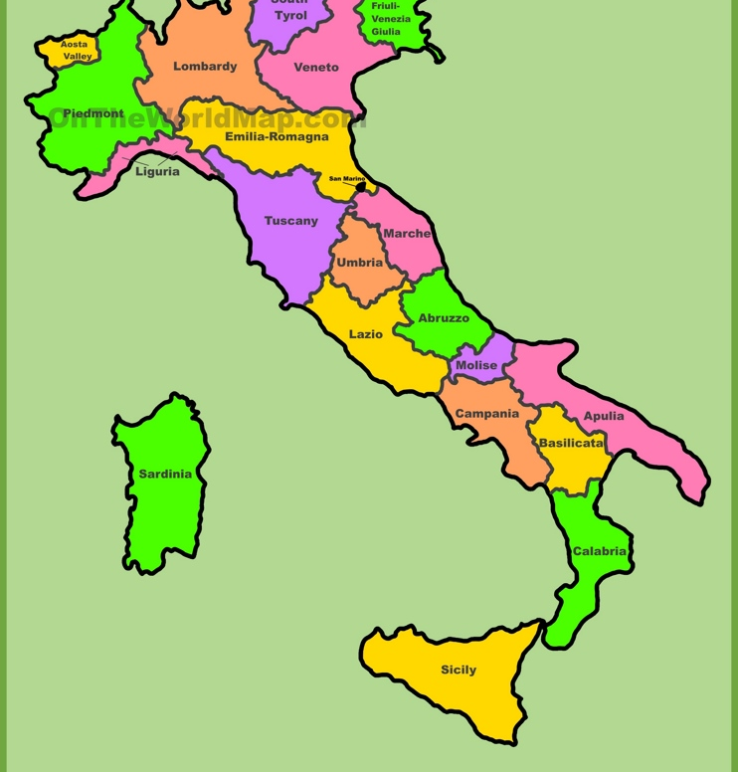
Aim of the project:
With this project I wanted to explore various aspects of Italian regions in order to understand which are the region that are most similar to each other.

Slide 3

Summary:
Abstract:
ct has been structured:
Research question
Creation of the dataset and variables explained
Exploratory analysis
Correlation plot
PCA (Bartlett’s test)
Multidimensional scaling
Hierarchical clustering
K-means clustering
PAM clustering
Model based clustering
Manova with the result of the cluster
Conclusion and further improvements

Slide 4

Research question:
Which are the factors that characterize the most the Italian regions in our dataset?
Is it possible to understand the correlation between some factor and improve the living conditions?
Which are the regions that are more similar to each other given the variables represented in the dataset?

Slide 5

Creation of the dataset:
The dataset has been created by me with the aim to analyze particular aspects of the Italian regions to which I was curious about, such as the number of people that are searching for an employment the number of asylum in every region and so on.
The data have been taken from:
DatiOpen.it | Il portale Italiano dell'Open Data
Which uses data from Istat.

Slide 6
Which variables did I choose?
All the variables are related to the year 2005 and specified for every region
Incidence of long time unemployment (female, male and total)
integrated home care for elderly people
Spread of child care services
Incidence for research and development with respect to the GDP for every region
Regional family poverty index
People at risk of poverty or social exclusion (female, male and total)
People in condition of high material deprivation (female, male and total)
Mafia-type organized crime rate
reported theft rate
Homicide rate by region
Reported robbery rate
Higher education rate

Slide 7
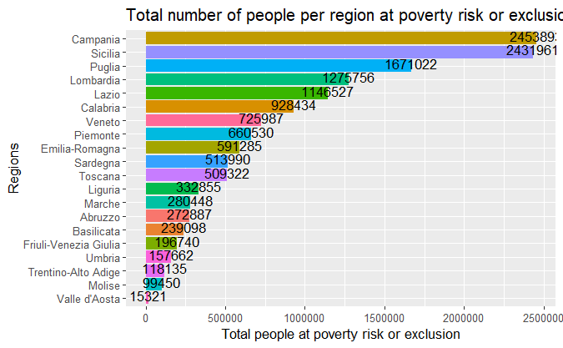
Exploratory analysis:
First I started by plotting the variables:

Slide 8
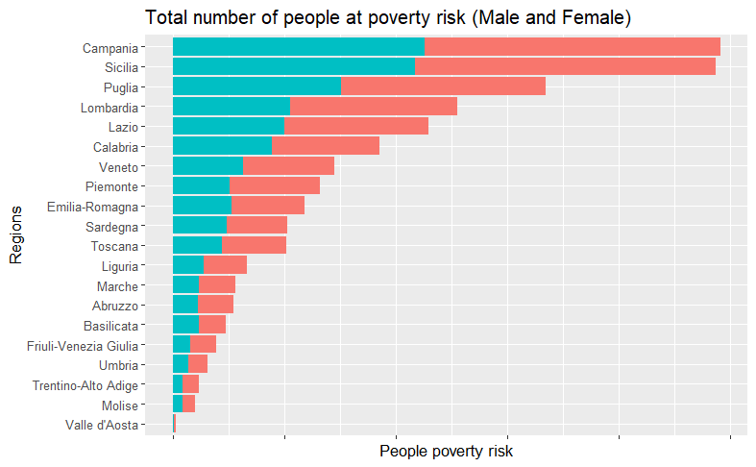
Stacked barplot: People at poverty risk
That shows both women and men

Slide 9
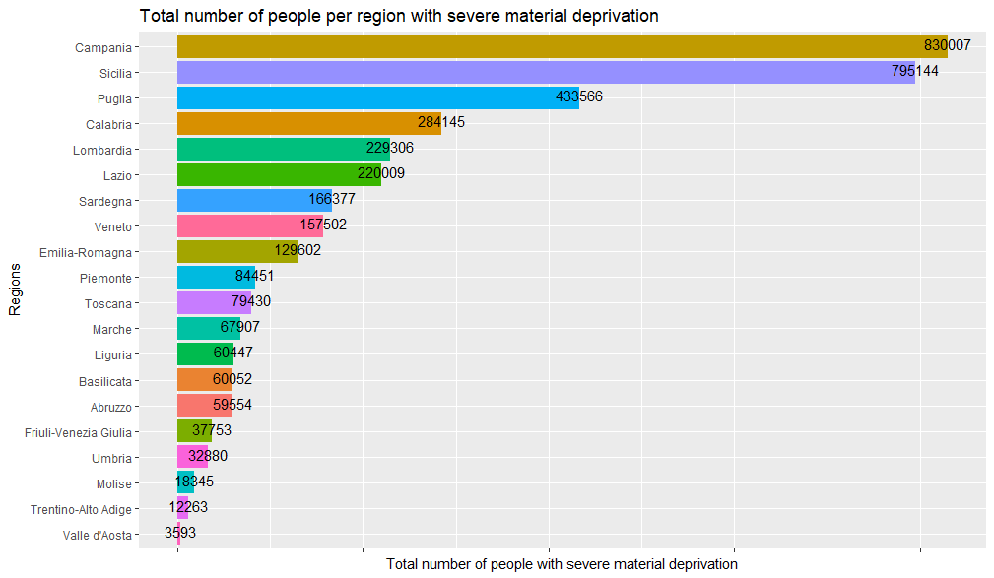

Slide 10
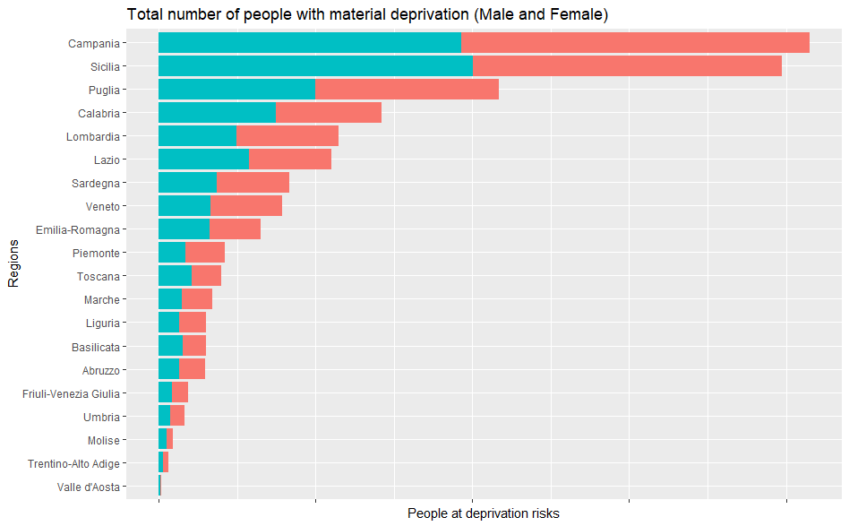

Slide 11
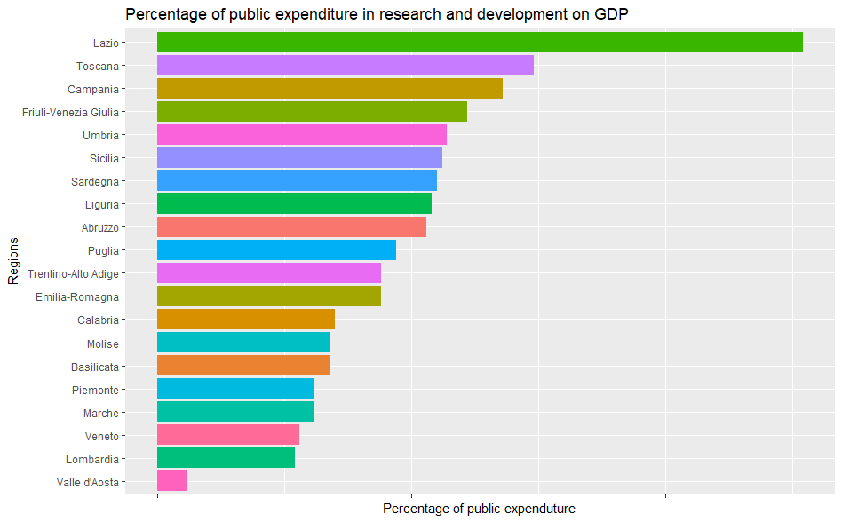

Slide 12
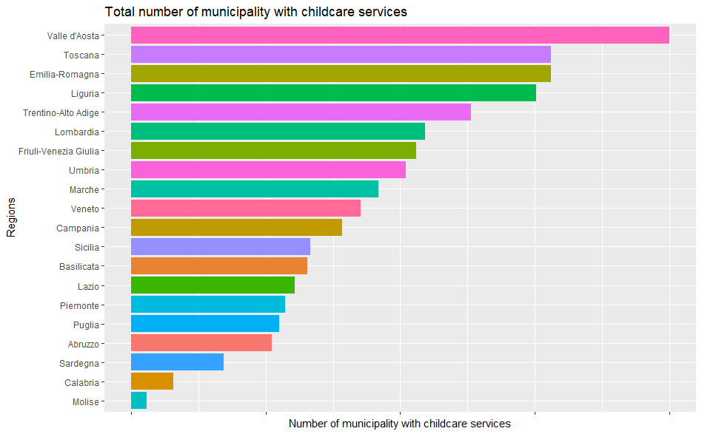

Slide 13
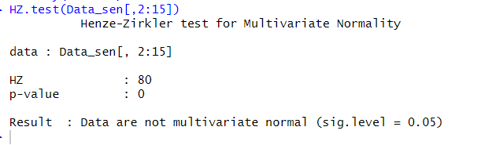
Test for multivariate normality:
I used Henze-Zirkler test for Multivariate Normality

Slide 14
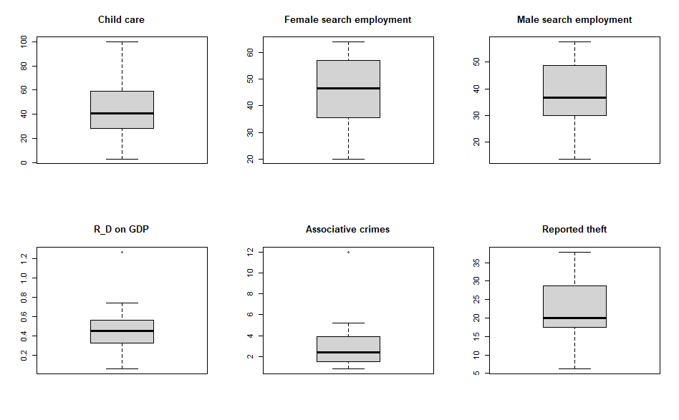
Boxplot to check the distribution of the variables and the outliers

Slide 15
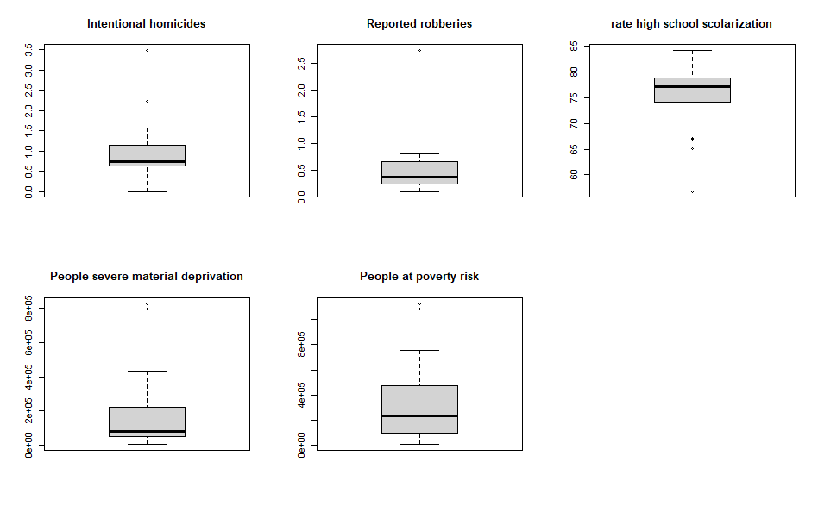
As we can see from the boxplot here we have some outliers:
1- Campania, Calabria
2-Campania
3-Campania, Puglia, Sicilia, Sardegna
4-Campania, Sicilia
5-Campania, Sicilia

Slide 16
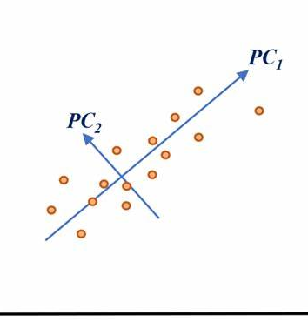
Principal component analysis
PCA
It is a dimensionality reduction technique
It helps identifying the relationship among different variables and computing them
PCA involves the transformation of variables in the dataset into a new set of variables which are called principal component
IMPORTANT: can be performed only on numerical variables

Slide 17
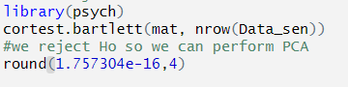
There are three very important step that we need to do before PCA:
Normalization:
Bartlett’s test
The variables need to be all on the same scale
In order to understand if it makes sense to perform PCA or not.
The null hypothesis is testing of the variables are ortogonal with each other.

Slide 18
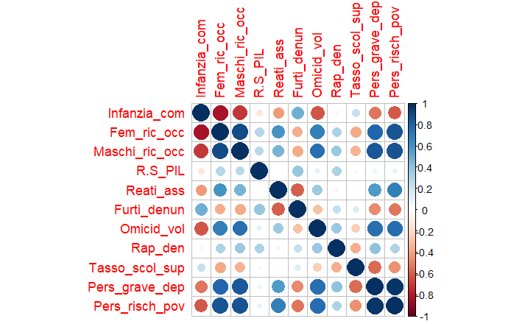
PCA
Principal component analysis

Slide 19
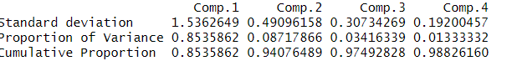
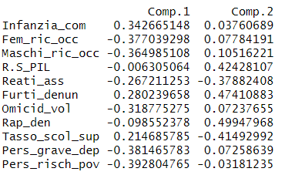
Summary PCA
PCA loadings

Slide 20
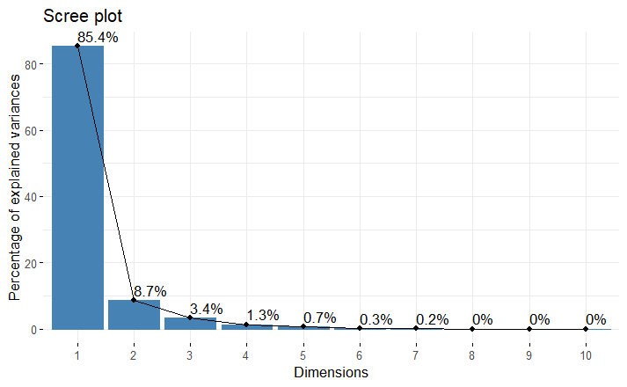

Slide 21
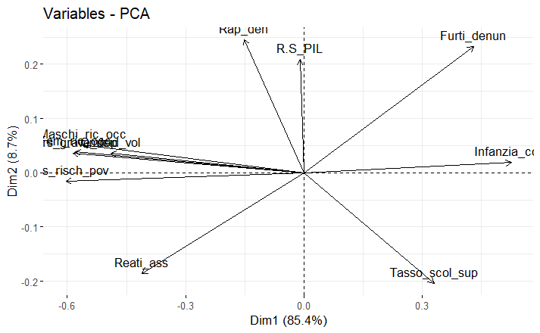

Slide 22
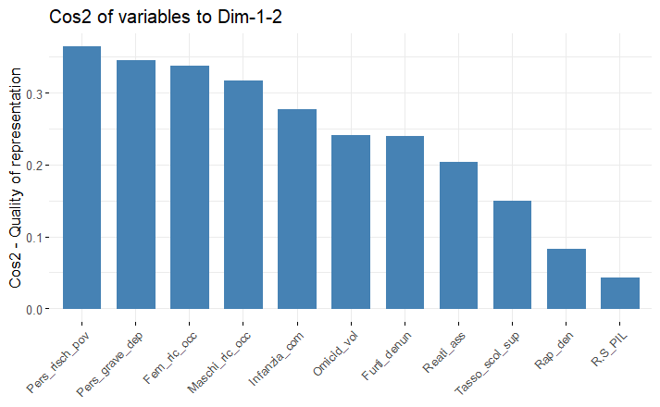

Slide 23
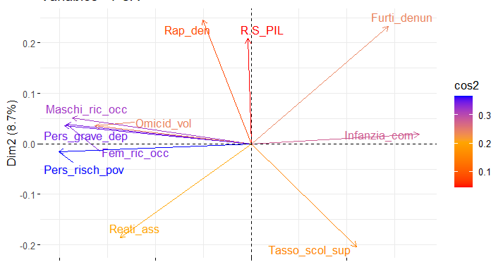
Combining biplot and variable importance

Slide 24
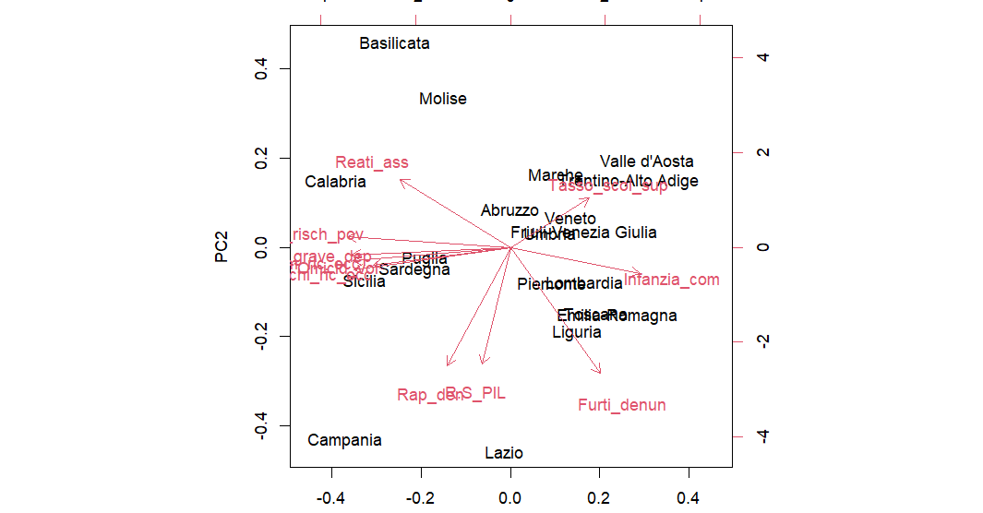

Slide 25
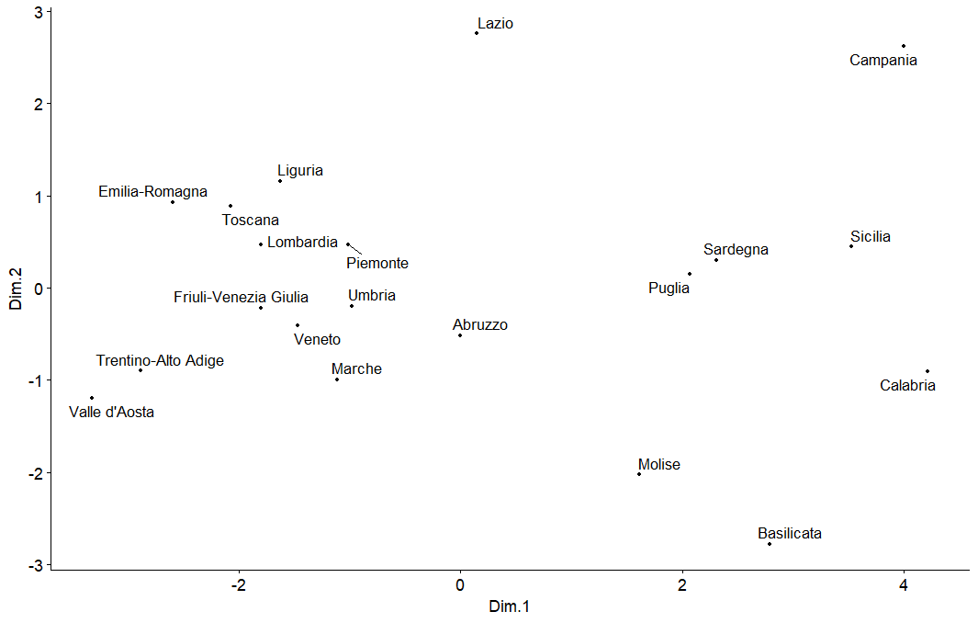
Multidimensional scaling : cmdscale()
Multidimensional scaling is a way to visualize the similarity of observations in a dataset in an abstract cartesian space
It is particularly useful when we want to understand the underlying structure of the data in terms of relationship between the data
AIM: represent the data in a low dimensional space while preserving the pairwise distances between the objects in the original high dimensional space
Positive correlated object are close together on the same side of the plot, as we can see on the leften side of the plot.
PCA is more focused on the dimensions themselves, and seek to maximize explained variance, whereas MDS is more focused on relations among the scaled objects.

Slide 26
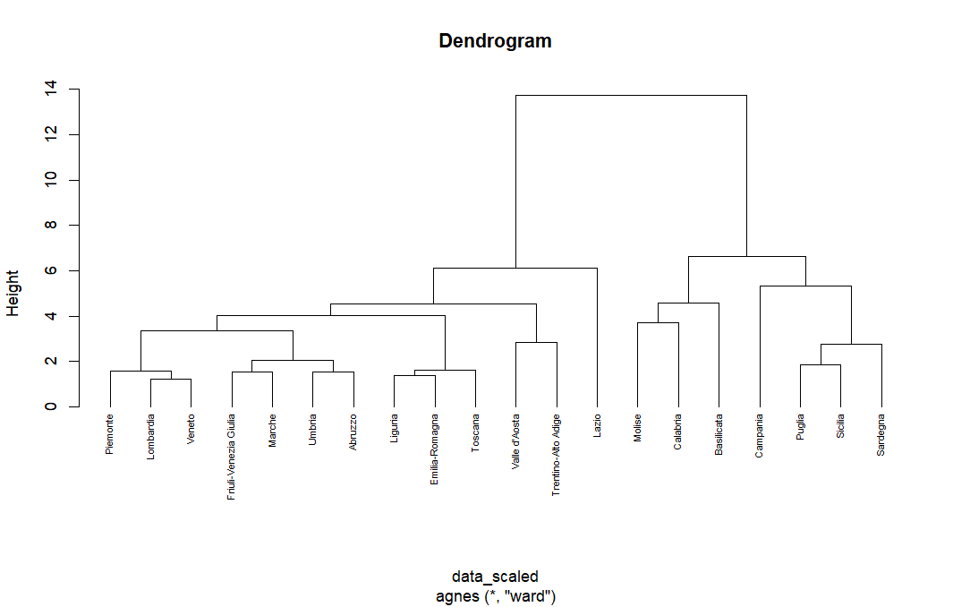
Hierarchical clustering
First check which kinf of link we could use with the function agnes() ward minimum variance

Slide 27
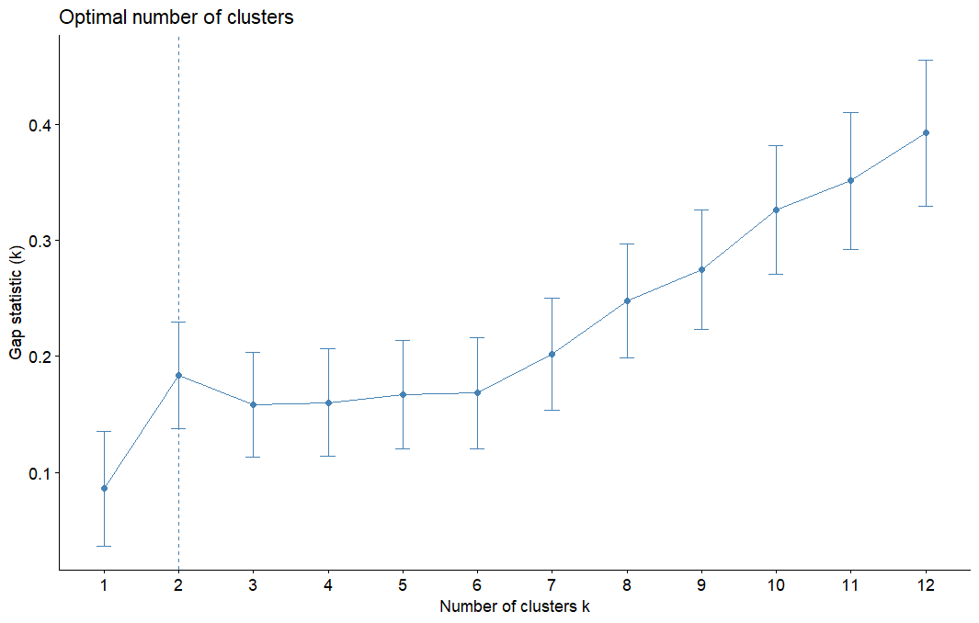

Slide 28
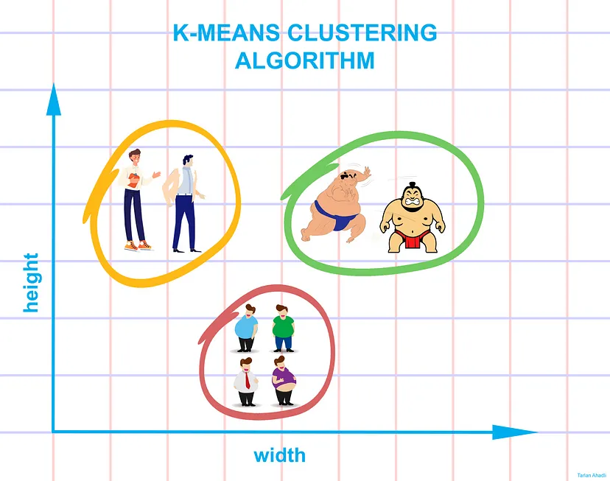
K-means clustering:
K-means clustering aims to partition data into k clusters in a way that data points in the same cluster are similar and data points in the different clusters are farther apart.
Euclidean distance and data need to be scaled
K-means clustering tries to minimize distances within a cluster and maximize the distance between different clusters.

Slide 29
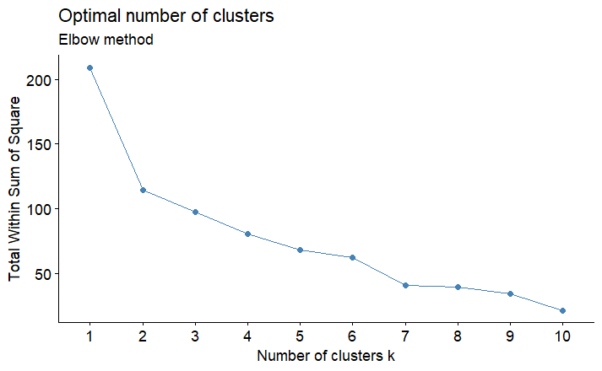
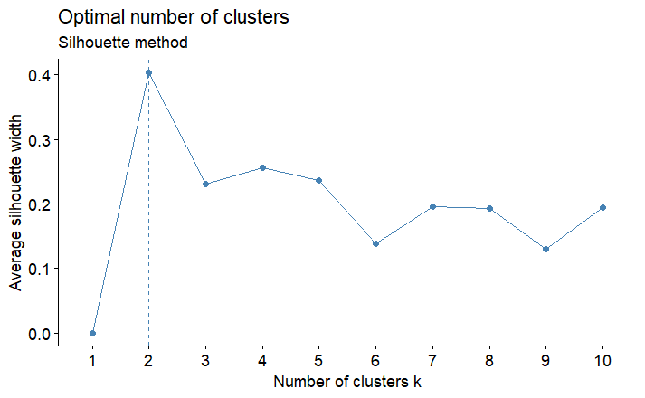
Choose the number of cluster:
Elbow method:
Silhouette method:

Slide 30
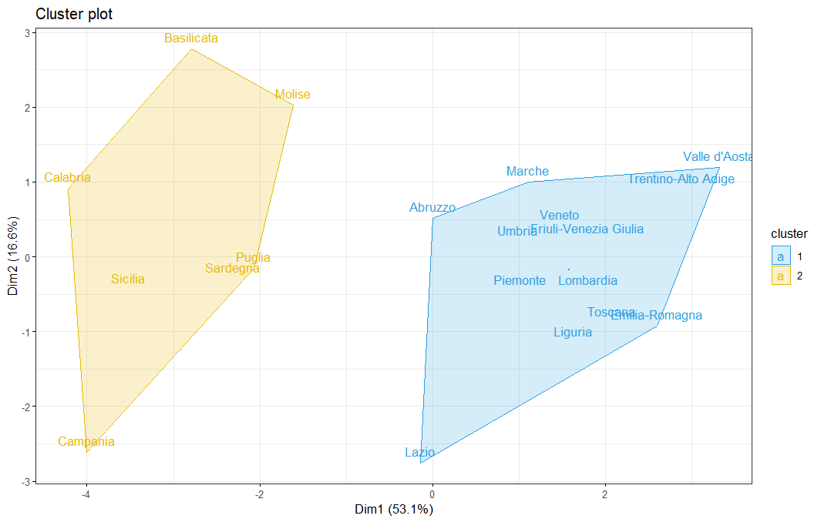
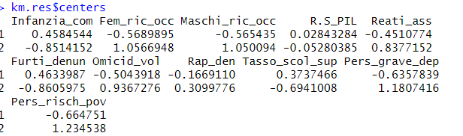
Cluster K-means
Plot
Centers

Slide 31
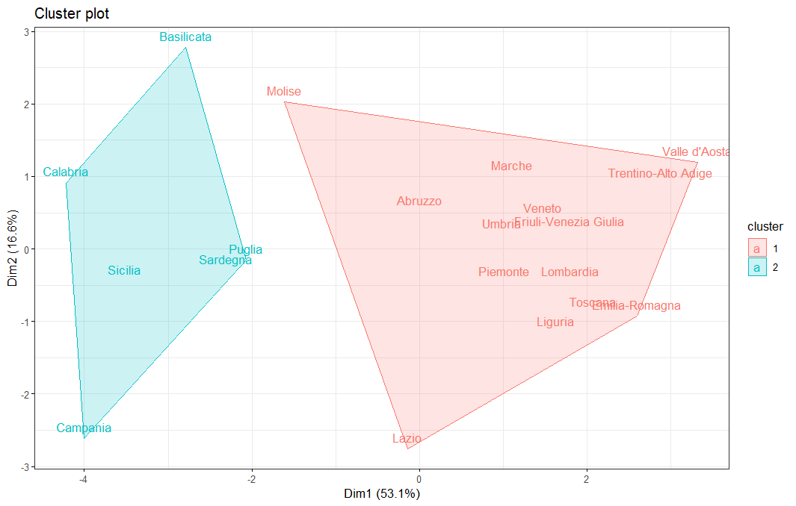
PAM
Plot:
Partitioning around medioids:
Is a robust version of K-means
The central poin is the median
It is good for single outliers but not for outlier clusters
The medioids are the object that represent the cluster and are in this case: Sicilia and Veneto

Slide 32
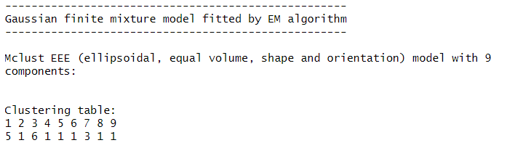
Model based clustering:
Mclust()
Model based clustering consider the data as coming from a distribution that is a mixture of two or more clusters
Unlike k-means model based clustering uses a soft assignment where each data point has a probability of belonging to each cluster
The model parameters can be estimated using the Expectation-maximization algorithm inizialized by hierarchical model-based clustering.
Each cluster is centered around the mean, geometric features are instead determined by the covariance matrix.
The best model is selected using the BIC

Slide 33
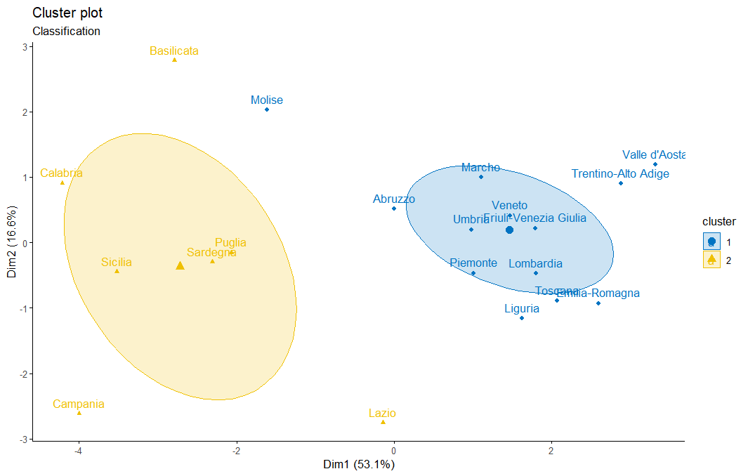
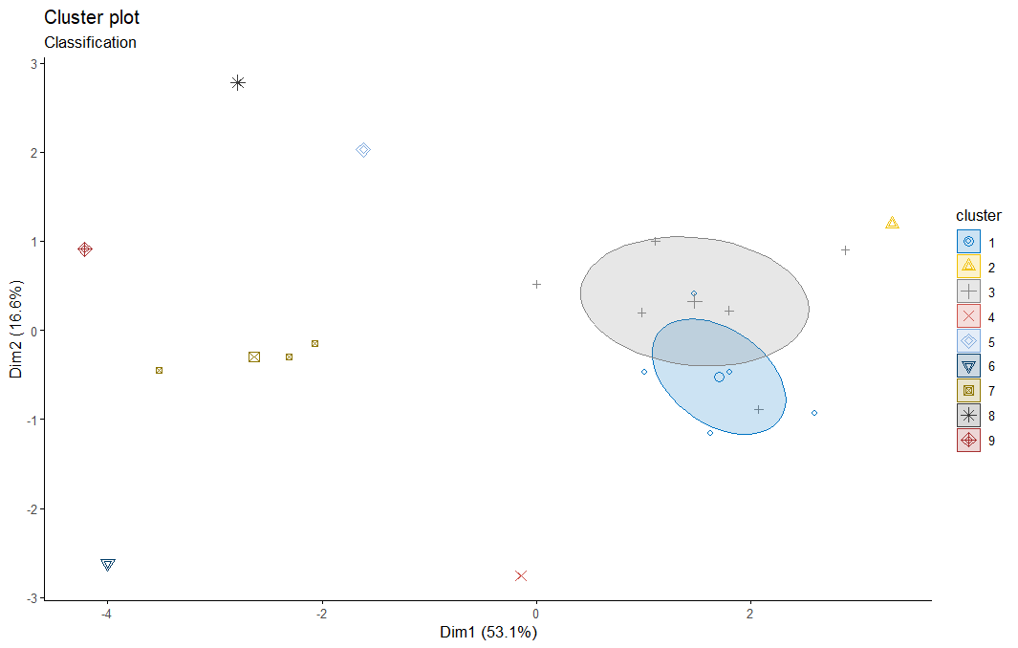
Plot: Model based clustering
Number of cluster:9
Force it to do 2 clusters

Slide 34
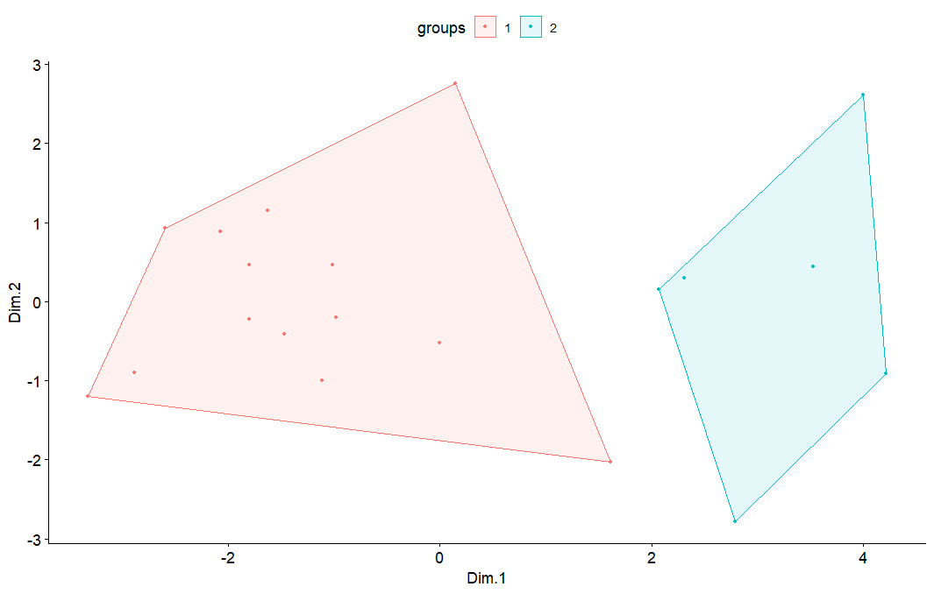

Slide 35
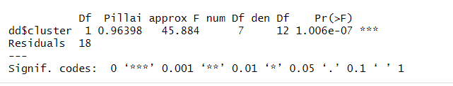
Manova
Add the cluster as a new feature to the data
Manova is the multivariate analysis of the variance.
It is a test that has as a null hypothesis that all the means are equal
It is mostly used to test in experiments to check if a certain treatment has been effective.
In this case we are going to use it just to check if the variables in the two different groups are significantly different to each other.
Since our variables are not normally distributed I am going to use the Pillai test statistic which is more robust.
Result of Manova

Slide 36
Conclusions and further improvements:
Conclusion:
Improvements:
Thanks to PCA and multidimensional scaling we end up having the same result.
We end up having what we actually expected, the region in which we have a higher degree of education are also the one with less poverty risks and unemployment rate and also the most decared thefth.
What I did not expect was that the Campania region is the one that has the most reserach and development investments.
Moreover we were also able to find cluster between the regions.
We should improve childcare facilities and enable the people to at least get the high school degree in the south of Italy and maybe someday things will change
It would have been good to have also the total number of tourist that visited that region during 2005, because I think that it woud have been very interesting to understand also this correlation
Moreover we know that in the south of Italy it is very common to work illegally so a future improvement would be to try to catch this latent variable.
Also the average wage could be a variable of interest in this context. (And maybe the cost of living in general)

Slide 37

Thank you !

